Slide 1
Diagnosis of Pregnancy
Dr Shanthi Serene Sylum V
HOD and Professor
Dept. Obstetrics and Gynaecology
SKHMC Kulasekharam

Slide 2
The reproductive period of a woman begins at menarche and ends in menopause ie 13–45 years.
Pregnancy is rare below 12 years and beyond 50 years.

Slide 3
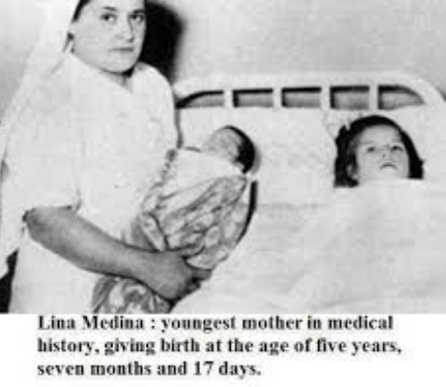
Lina Medina in Lima, Peru was the youngest one, delivery by cesarean on 14th May 1939

Slide 4
‘World’s oldest mother’ gives birth at the age of SEVENTY
Daljinder Kaur and her husband Mohinder Singh Gill from Amritsar welcomed a son into the world after two years of IVF treatment in Haryana on
19th April 2016.

Slide 5
DURATION OF PREGNANCY:
The duration of pregnancy has traditionally been calculated by the clinicians in terms of 10 lunar months or 9 calendar months and 7 days or 280 days or 40 weeks, calculated from the first day of the last menstrual period.
This is called menstrual or gestational age.

Slide 6
fertilization or ovulatory age
But, fertilization usually occurs 14 days prior to the expected missed period and in a previously normal cycle of 28 days duration, it is about 14 days after the first day of the period.
Thus, the true gestation period is to be calculated by subtracting 14 days from 280 days, i.e. 266 days.
This is called fertilization or ovulatory age and is widely used by the embryologist.

Slide 7
FIRST TRIMESTER -FIRST 12 WEEKS
SUBJECTIVE SYMPTOMS:
Amenorrhea
Morning sickness
Frequency of micturition
Breast discomfort
Fatigue

Slide 8
Amenorrhea
Amenorrhea during the reproductive period in an otherwise healthy individual having previous normal periods, is likely due to pregnancy unless proved otherwise.
However, cyclic bleeding may occur up to 12 weeks of pregnancy, until the decidual space is obliterated by the fusion of decidua vera with decidua capsularis.
Such bleeding is usually scanty, lasting for a shorter duration than her usual and roughly corresponds with the date of the expected period. This is termed as placental sign.
This type of bleeding should not be confused with the commonly met pathological bleeding, i.e. threatened abortion.
Pregnancy, however, may occur in women who are previously amenorrheic — during lactation and puberty.

Slide 9
Morning sickness
(Nausea and vomiting) is inconsistently present in about 70% cases, more often in the first pregnancy than in the subsequent one.
It usually appears soon following the missed period and rarely lasts beyond 16 weeks.
Its intensity varies from nausea on rising from the bed to loss of appetite or even vomiting.
It does not affect the health status of the mother

Slide 10
Frequency of micturition
Frequency of micturition is quite troublesome symptom during 8–12th week of pregnancy. It is due to
(1) resting of the bulky uterus on the fundus of the bladder because of exaggerated anteverted position of the uterus
(2) congestion of the bladder mucosa
(3) change in maternal osmoregulation causing increased thirst and polyuria. As the uterus straightens up after 12th week, the symptom disappears.

Slide 11
Breast discomfort Fatigue
Breast discomfort in the form of feeling of fullness and ‘pricking sensation’ is evident as early as
6–8th week specially in primigravidae.
Fatigue is a frequent symptom which may occur early in pregnancy.

Slide 12
OBJECTIVE SIGNS:
Breast changes
nipple and the areola
Montgomery’s tubercles
Thick yellowish discharge
Per abdomen
Pelvic changes
Jacquemier’s or Chadwick’s sign
Vaginal sign:
Goodell’s sign
Uterine signs
Hegar’s sign
Palmer’s sign

Slide 13
OBJECTIVE SIGNS:
Breast changes are valuable only in primigravidae
In multiparae, the breasts are enlarged and often contain milk for years.
The breast changes are evident between 6 and 8 weeks.
There is enlargement with vascular engorgement evidenced by the delicate veins visible under the skin

Slide 14
The nipple and the areola (primary) become more pigmented specially in dark women.
Montgomery’s tubercles are prominent.
Thick yellowish secretion (colostrum) can be expressed as early as 12th week.

Slide 15
Per abdomen —
Uterus remains a pelvic organ until 12th week, it may be just felt per abdomen as a suprapubic bulge.

Slide 16
Pelvic changes
The pelvic changes are diverse and appear at different periods.
Jacquemier’s or Chadwick’s sign:
It is the dusky hue of the vestibule and anterior vaginal wall visible at about 8th week of pregnancy.
This discoloration is due to local vascular congestion.

Slide 17
Vaginal sign:
(a) Apart from the bluish discoloration of the anterior vaginal wall
(b) The walls become softened
(c) Copious non-irritating mucoid discharge appears at 6th week
(d) There is increased pulsation, felt through the lateral fornices at 8th week called Osiander’s sign.

Slide 18
Cervical signs:
(a) Cervix becomes soft as early as 6th week (Goodell’s sign), a little earlier in multiparae. The pregnant cervix feels like the lips of the mouth, while in the non-pregnant state, like that of tip of the nose.
(b) On speculum examination, the bluish dscoloration of the cervix is visible. It is due to increased vascularity.

Slide 19
Uterine signs:
(a) Size, shape and consistency —
The uterus is enlarged to the size of hen’s egg at 6th week, size of a cricket ball at 8th week and size of a fetal head by 12th week.
Th e pyriform shape of the non-pregnant uterus becomes globular by 12 weeks.
There may be asymmetrical enlargement of the uterus if there is lateral implantation. This is called Piskacek’s sign where one half is more firm than the other half. As pregnancy advances, symmetry is restored.
The pregnant uterus feels soft and elastic.

Slide 20
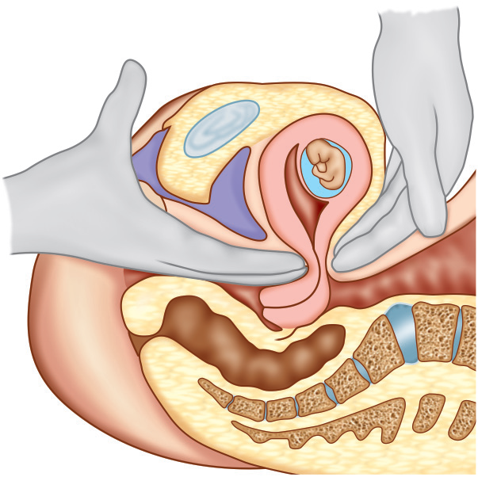
Hegar’s sign:
It is present in two-thirds of cases.
It can be demonstrated between 6 and 10 weeks, a little earlier in multiparae. This sign is based on the fact that:
(1) upper part of the body of the uterus is enlarged by the growing fetus
(2) lower part of the body is empty and extremely soft
(3) the cervix is comparatively firm.
Because of variation in consistency, on bimanual examination (two fingers in the anterior fornix and the abdominal fingers behind the uterus), the abdominal and vaginal fingers seem to appose below the body of the uterus.
Examination must be gentle to avoid the risk of abortion.

Slide 21
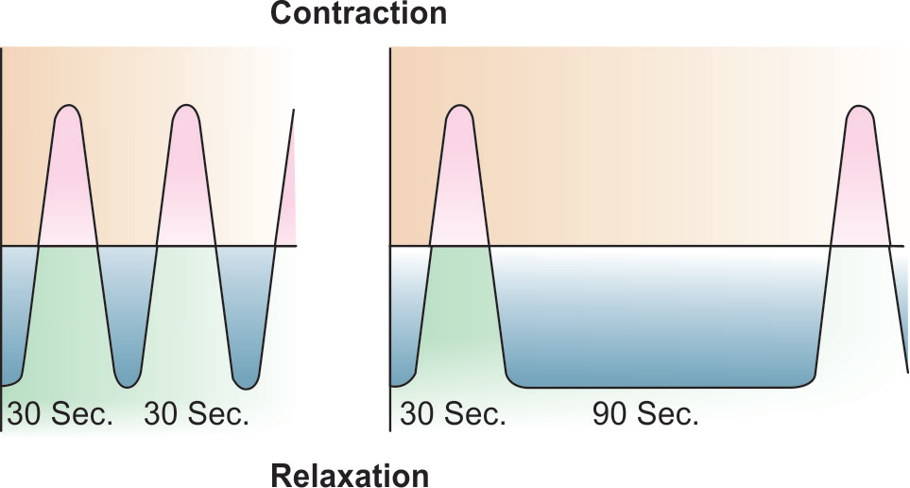
Palmer’s sign:
Regular and rhythmic uterine contraction can be elicited during bimanual examination as early as 4–8 weeks.
Palmer in 1949, first described it and it is a valuable sign when elicited.
To elicit the test, the uterus is cupped between the internal fingers and the external fingers for about 2–3 minutes. During contraction, the uterus becomes firm and well defined but during relaxation, it becomes soft and ill defined.
While the contraction phase lasts for about 30 seconds, with increasing duration of pregnancy, the relaxation phase increases . After 10th week, the relaxation phase is so much increased that the test is difficult to perform.
Graphic representation -
At 4-8th week & at 10th week

Slide 22
Braxton-Hicks Contractions
Uterine contraction in pregnancy has been named after Braxton-Hicks who first described its entity during pregnancy.
From the very early weeks of pregnancy, the uterus undergoes spontaneous contraction.
This can be felt during bimanual palpation in early weeks or during abdominal palpation when the uterus feels firmer at one moment and softer at another.
The contractions can be excited by rubbing the uterus.
The contractions are irregular, infrequent, spasmodic and painless without any effect on dilatation of the cervix.
The patient is not conscious about the contractions.
Intrauterine pressure remains below 8 mm Hg.
Near term, the contractions become frequent with increase in intensity so as to produce some discomfort to the patient.
Ultimately, it merges with the painful uterine contractions of labor.

Slide 23
DC Dutta’s Textbook of Obstetrics including Perinatology & Contraception Eighth Edition 2015 Edited by Hiralal Konar JAYPEE.

Slide 24
Thank you

